Slide 1
BARCELONA TOURIST GUIDE
INDEX
1.- Sagrada Familia CHURCH. - Elsa
2.- Ciutadella PARK and ZOO. - Adrià and Francisco
3.- The Ramblas BOULEVARD - Ariadna and Africa
4.- AQUARIUM - Marcos and Adrià
5- MAZE PARK - Ethan and Sergi

Slide 2
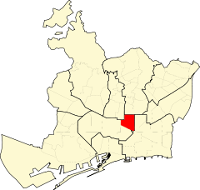
1-SAGRADA FAMÍLIA
SAGRADA FAMÍLIA is in the center of Barcelona.
Next to Sagrada Família there are restaurants, shops, parks, some gardens, etc.
You can walk, play in the parks, enter to visit the Sagrada Família ……

Slide 3
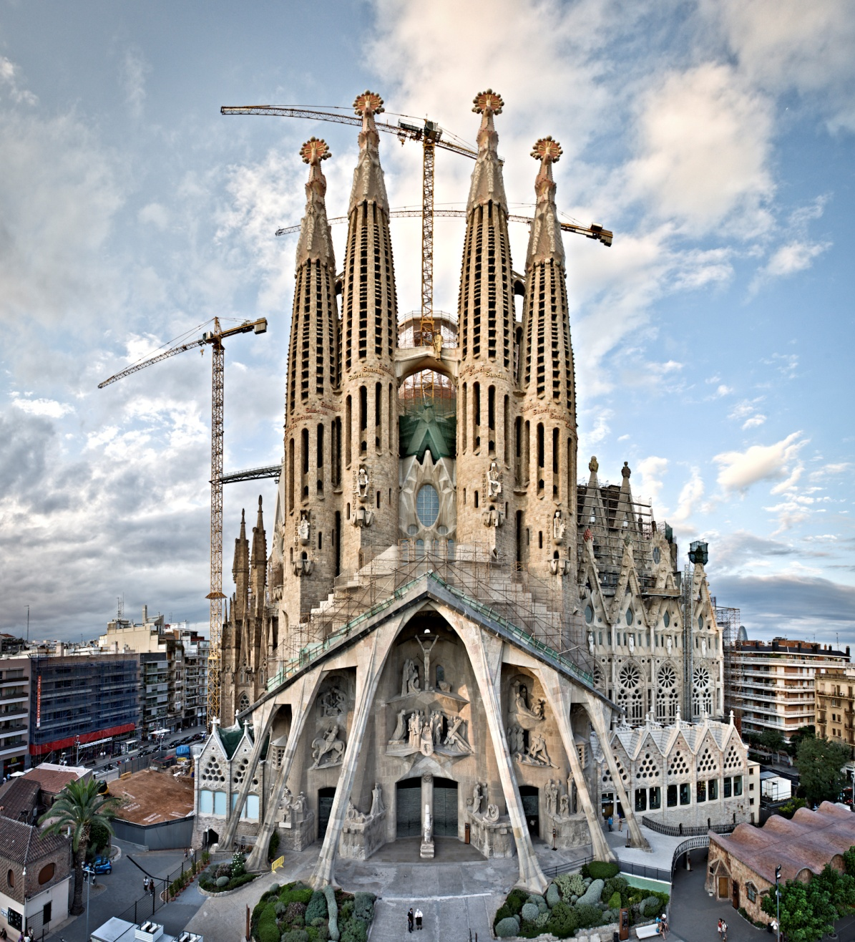

Slide 4
On the left, now . On the right, finished

Slide 5
2.- Ciutadella PARK and ZOO
It is in Barcelona, next to Barceloneta neighborhood
There is the Zoology museum and the Botanical museum. About animals and plants .
There is the Barcelona Zoo.

Slide 6
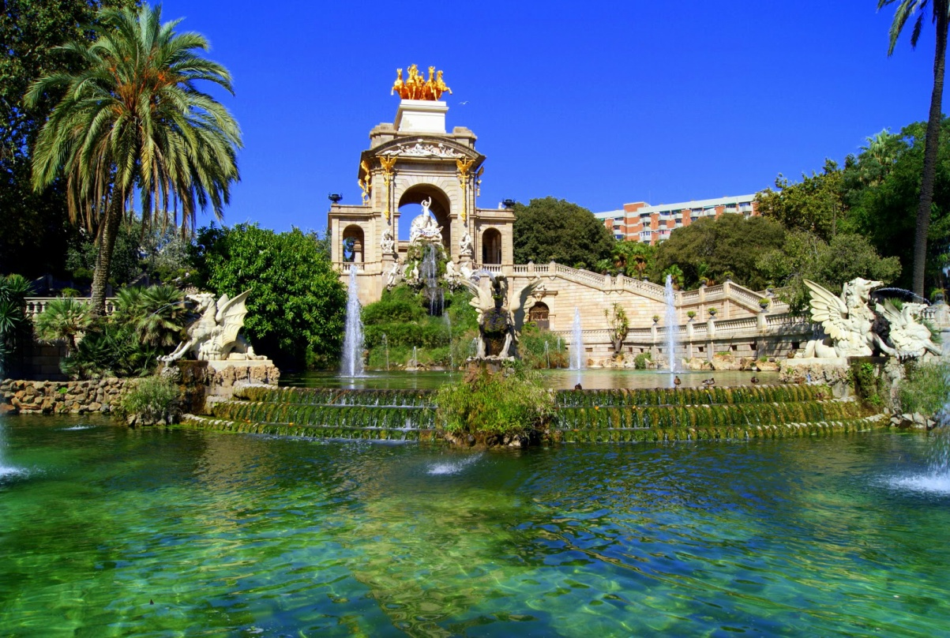
There are some restaurants and gardens .
You can walk, have a picnic, run, you can row in a lake and visit the animals in the Zoo.

Slide 7
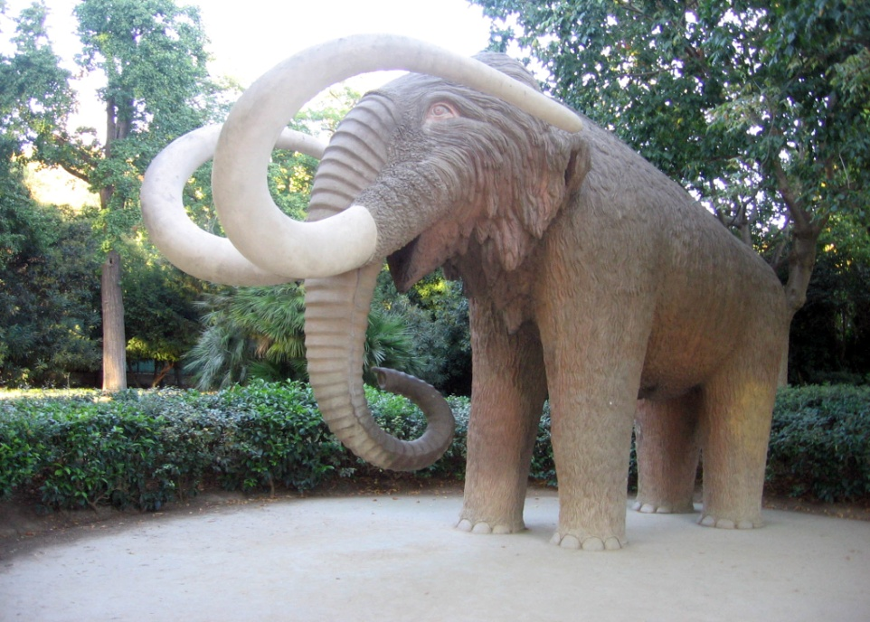

Slide 8
3.- THE RAMBLAS BOULEVARD

Slide 9
JHJ
It’s in the center of Barcelona
The rambla Bulevard is very long , important and very famous.
There is the Boqueria food market , the Colon column statue, lot of shops, bars and restaurants.
In the Boqueria food market you can drink
the typical fruit juices.
You can visit the WAX museum.

Slide 10
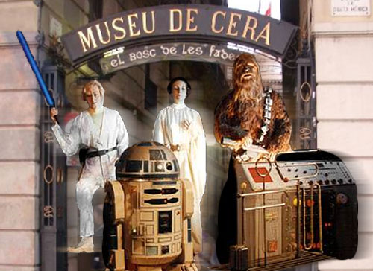
BOQUERIA FOOD MARKET AND WAX MUSEUM

Slide 11
4.- THE AQUARIUM OF BARCELONA
The aquarium of Barcelona is my favourite place to visit.

Slide 12
The aquarium of Barcelona is in the centre of the city, next to the sea.

Slide 13
In the aquarium of Barcelona there is a restaurant and many shops.
In this place you can see the fish and the sharks.
You can go shopping in the shops and eat in the restaurants.

Slide 15
5.- THE MAZE PARK
The Maze Park is in Vall d’Hebron neighborhood .
Notes:
15

Slide 16
In this place there are a lot of people and plants corridors to hide there.
There is a restaurant where you can eat very good food, for example paella.

Slide 17
