Slide 1
MONTGAT TOURIST GUIDE
INDEX
1.-“MALAMAR”( A surfboard place) - Martina and Victor
2.- THE RAILWAY TUNNEL and TRAIN STATIONS - Julen and Edu
3.- THE WATCH TOWER (Torre de Guaita) - Dani and Nadia
4.- SAINT MARTIN HERMITAGE - Maria and Dario
5.- “Tramvia” PARK - Alex and Kilian
6.- “Turó” PARK – Nayara and Laia
7.- THE LIBRARY - Marta and Abril
8.- SPORT CENTER - David and Raúl
9.- THE TOWN HALL – Roger i Aina

Slide 2
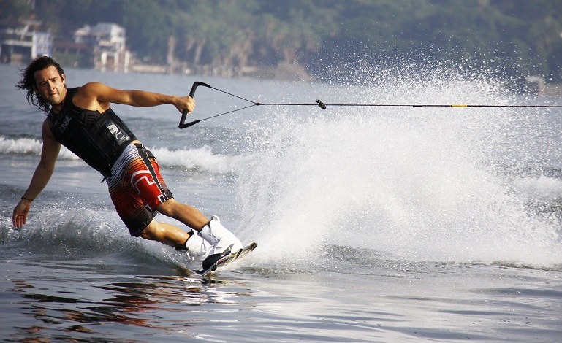
1.- “MALAMAR”
A surf board place in Montgat

Slide 3
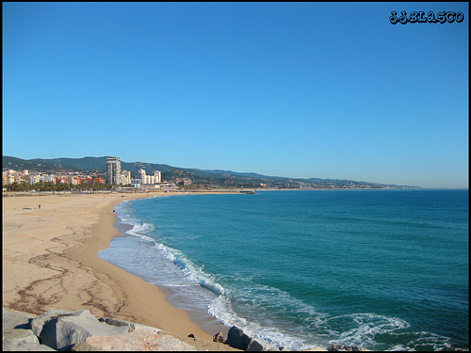
Ít is next to Montgat beach

Slide 4
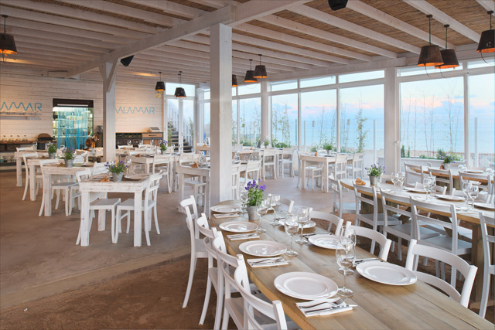
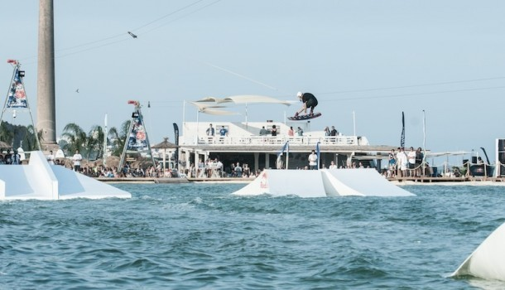
There is a restaurant and a big swimming pool

Slide 5
ACTIVITIES IN MALAMAR
WAKE BOARD
CANOENING
WATER SKIING

Slide 6
2.- TUNNEL AND RAILWAY STATIONS
Trains arrive every five or ten minutes to Montgat train station.
The tunnel is the first railway tunnel in Spain.

Slide 7
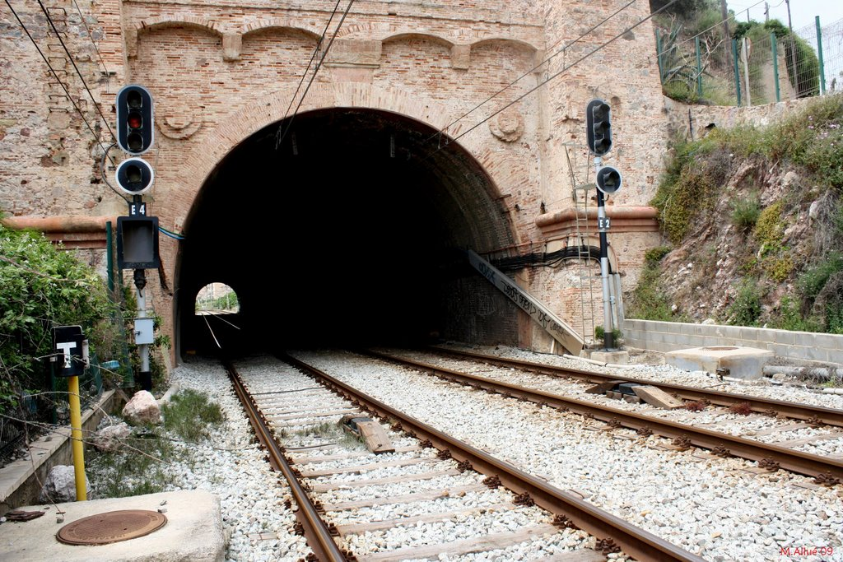
The tunnel is in Montgat and there are many trains.

Slide 8
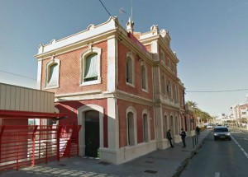
The train station opens at half past six am and closes at twelve o'clock pm.

Slide 9
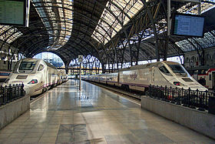
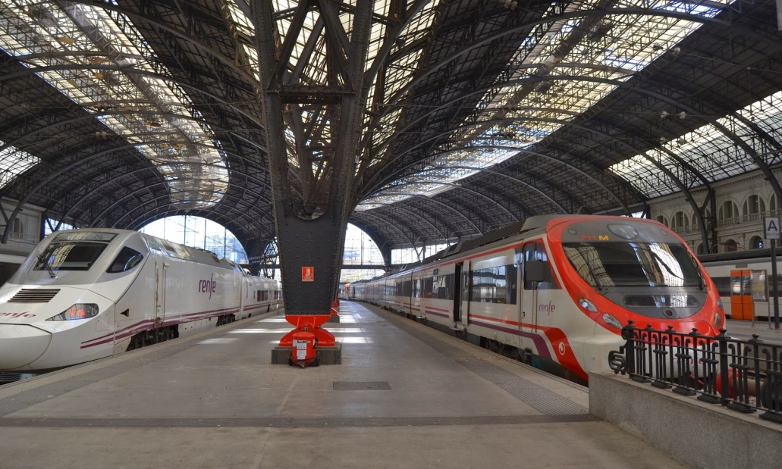
You can travel to and around Barcelona.

Slide 10
3.- THE WATCH TOWER ( TORRE DE GUAITA)

Slide 11
THE WATCH TOWER (GUAITA)
My favourite place is the watch tower “TOWER GUAITA”
In this place there is a museum
You can see some paintings in the museum.
It usually is closed. It sometimes opens at the weekends, from9:30 A.M to 13:00 P.M
Prize: 6 euros kids and 10 euros adults.
This is an amazing place to visit.

Slide 13
4.- SAINT MARTIN HERMITAGE
NAME: Dario and Maria

Slide 14
The Sant Martin hermitage is a beautiful ancient building.
The Sant Martin hermitage is next to Montgat tennis club.
The priest celebrate masses there, he also prays to the christian God.
It opens to celebrate normally at the weekends.
It’s free. You need to ask to the priest in Montgat church if do you want to visit this place.
It is in the Turó Mar neighborhood.

Slide 15
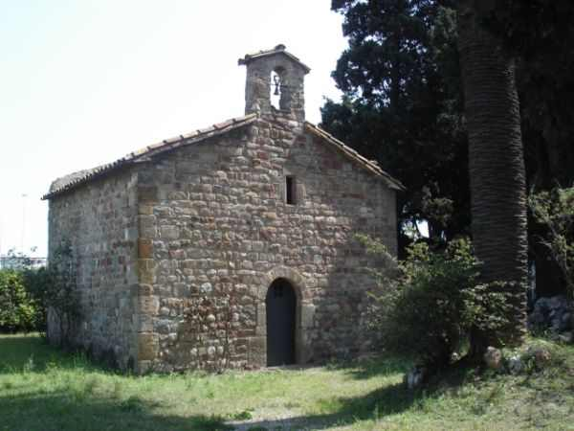

Slide 16
6.- TURO PARK
LAIA AND NAYARA
6th A

Slide 17
My favourite place is Turo park
It is fantastic for vist and to meet friends. It is really beautiful to see the nature in this place.
This place is in Montgat.
There is a garden and there are a lot of trees and plants. From there you can see the Mediterranean sea.
You can play in this park with your friends.
It is open everyday, all time.
The entrance is free.

Slide 18
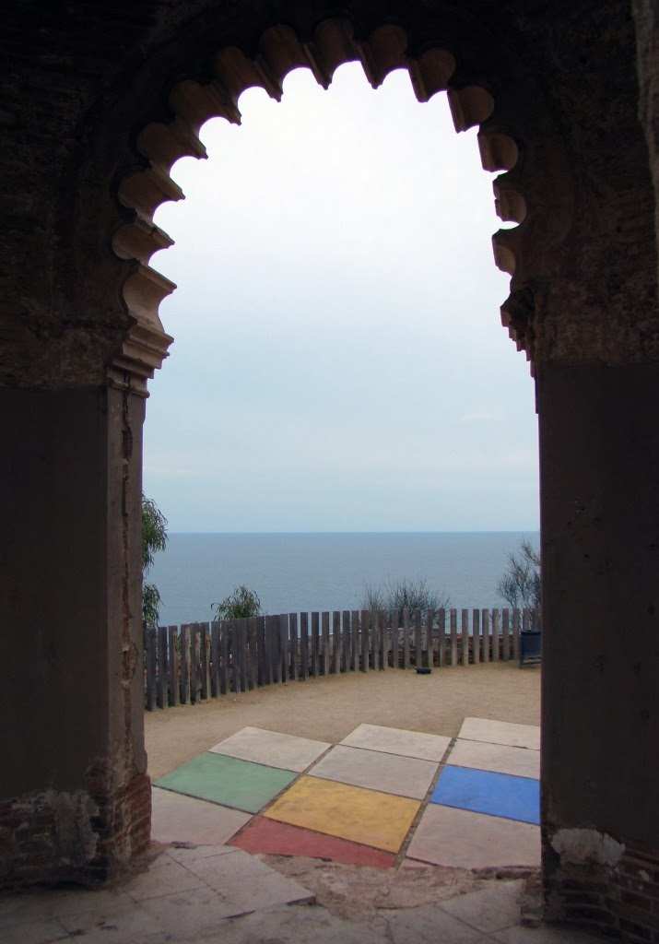

Slide 19
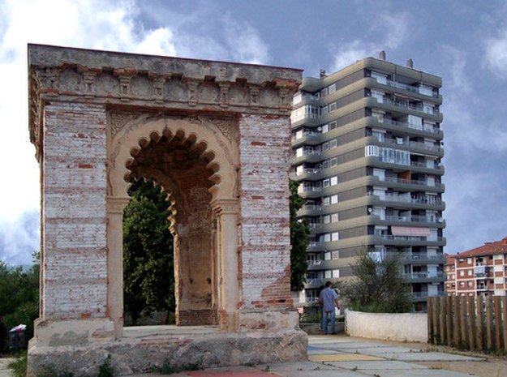

Slide 20
7.- “TIRANT LO BLANC” LIBRARY
The library of Montgat.

Slide 21
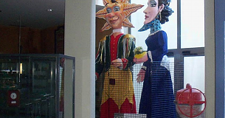
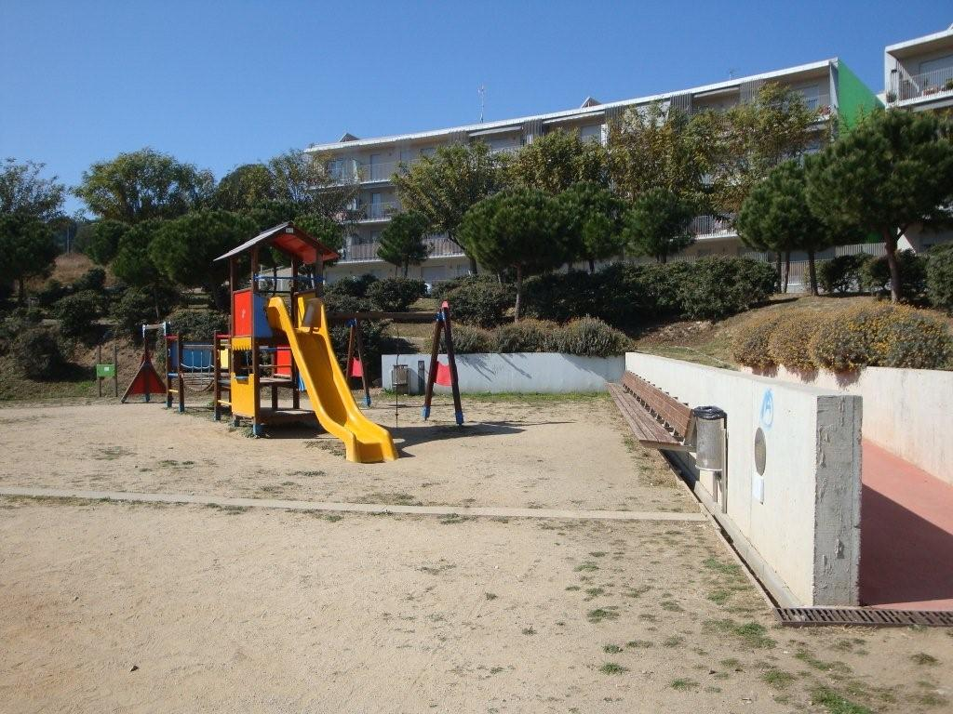
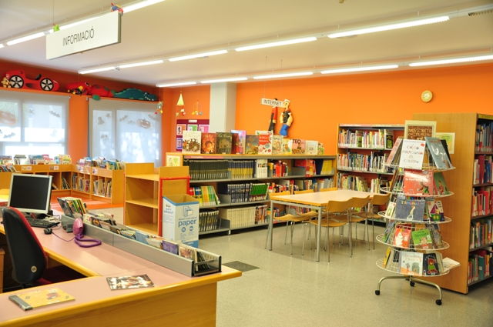
THERE IS...
A park
Two giants
A events hall
A children zone

Slide 22
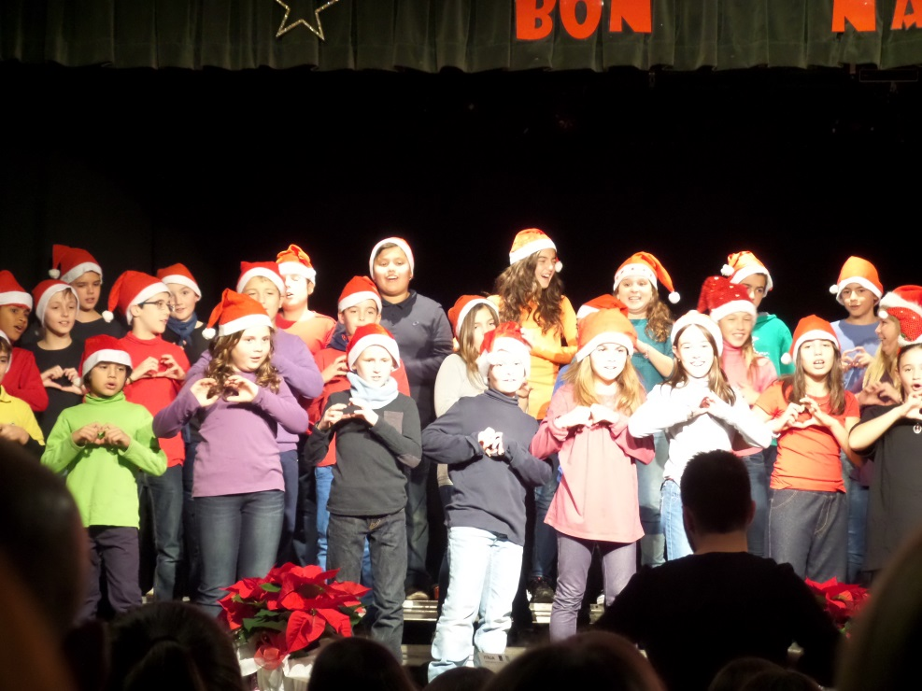
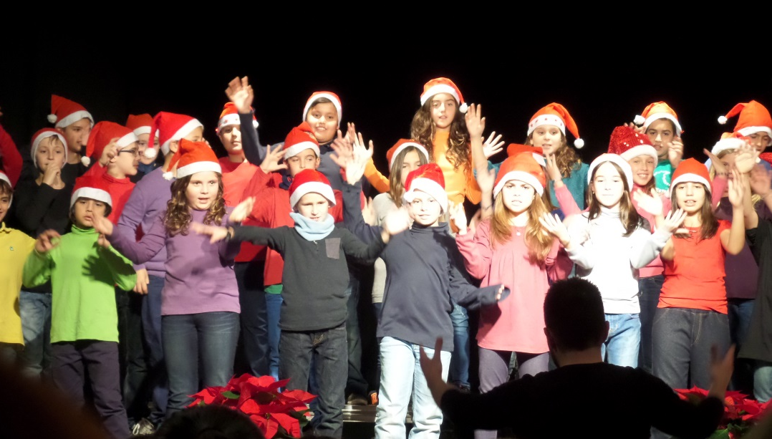
YOU CAN DO...
In Christmas, we go to events hall and we sing traditional Christmas songs.

Slide 23
8.- THE SPORT CENTER
DAVID LÓPEZ D0MINGUEZ
ROGER CALERO DURAN

Slide 24
The sport center is my favourite place in Montgat.
It's next to the library.
In this place there is a football stadium.
In this place you can play football.
It opens only in the afternoon at workdays .
It always opens at the weekend .
It's a free zone to enter but at the restaurant you need to pay your food or drink.

Slide 26
9.- THE TOWN HALL
THE TOWN HALL
It’s in the centre of Montgat.

Slide 27
There are a lot of rooms.
The Montgat’s Mayor works there.
There is the information office.
You can ask for information.
You can go to see a wedding
It opens at 9 : 00 am and closes at 14 : 00 pm.
The entrance is free.

Slide 28
