Slide 1
Estonia
Created by Kaire Hakk 2015

Slide 2
The republic of Estonia and Europe

Slide 3
Some facts about Estonia (1)
The Republic of Estonia is a country in Northern Europe;
Estonia is located on the eastern coast of the Baltic Sea;
The capital of Estonia is Tallinn;
Estonia has an area of 45 227 km²(the Tartu Peace Treaty of 1920 defined 47 549 km²)
The population is about 1 340 000 people
Population density: 31 people per km²

Slide 4
Some facts about Estonia (2)
Type: Parliamentary democracy;
Legislature: unicameral Riigikogu;
High court: Supreme Court;
Administrative regions: 15 counties;
Estonia has 1521 islands and the biggest of them are Saaremaa and Hiiumaa.
Estonian currency is the Euro;
The main religioon is Lutheran.

Slide 5
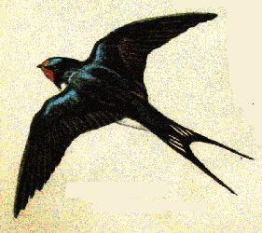
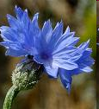
Symbols of Estonia
The colours of Estonian flag are blue, black and white;
National flower is cornflower;
National bird is swallow;
National Coat of Arms is a golden shield which includes three lions in the middle, with oak branches along the side of the shield;
National stone is limestone;
National anthem is ,,Mu isamaa , mu õnn ja rõõm’’. („My fatherland, my happiness and joy“)

Slide 6
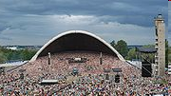
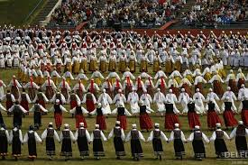
ESTONIAN CULTURE
The Estonian Song Festival is one of the largest choral events in the world. It’s held every four years on the Tallinn Song Festival Grounds.
Thousans of dancers wear national costumes as they dance around the pitch. Dance Festival usually takes place at the same weekend as the Song Festival.

Slide 7
Our regioon: Põlva county
First mentioned in 1452;
Area: 2,165 km²;
Population: 27,452;
Population density:12.7 hab/km²;
Ethnicity: 97% Estonians;
The Green County

Slide 8
Our municipality: Orava
Area: 175,5 km²
Population : 700 people
Population density: 3,9 hab/km²

Slide 9
the sights
Tallinn `s Old Town
Unesco heritage
Sandstone caves in Piusa

Slide 10
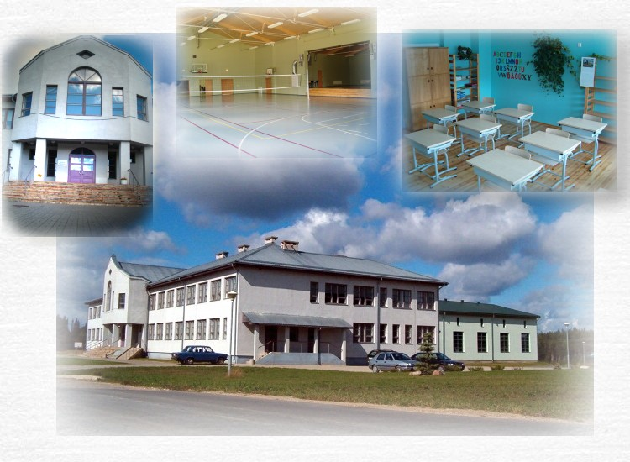
Orava school
Some facts
Students in nature
Successor of Hanikase Basic School (since 1873)
In 2015 there are :
12 teachers
58 students aged 6-16
19 preschool children

Slide 11
view from the sky

Slide 12
references
https://et.wikipedia.org/wiki/Orava_vald#/media/File:Eesti_orava_vald.png
https://et.wikipedia.org/wiki/Orava_vald
https://et.wikipedia.org/wiki/Orava_vald#/media/File:PiusaKoopad.jpg
https://www.google.ee/webhp?sourceid=chrome-instant&ion=1&espv=2&ie=UTF-8#q=estonia%20powerpoint
https://www.google.ee/webhp?sourceid=chrome-instant&ion=1&espv=2&ie=UTF-8#q=estonia%20powerpoint

